Slide 1

Hotel Bookings Cancellation Prediction
Prediction of hotel booking cancellation probability, based on the booking details
Dana Benyamin Hassid
Katya Arnold
Egor Genov
Ran Amran
Binyamin Rosenstein
Submitted By
Maya Babu

Slide 2

Motivation
CORRECT MANAGEMENT
INFORMED DECISION MAKING
BOOKING DETAILS
Detecting the key features about the reservations.
Predicting the correct number of visitors will allow for more efficient management of workers, food etc.
Taking in consideration particular booking details will allow for predicting the outcome of the booking
Your logo
1
Notes:
קטיה

Slide 3
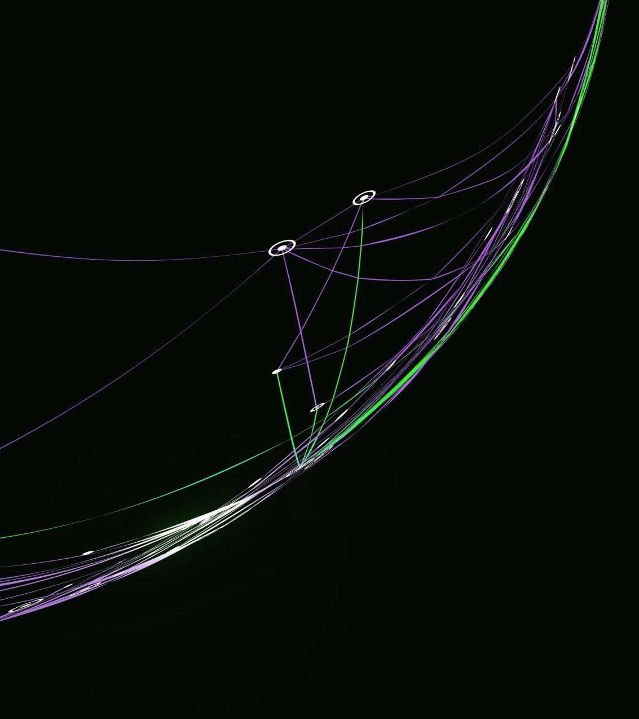
Introduction
Booking cancellations greatly impact hospitality industry demand management. Annually, over 140 million online bookings occur, with major travel websites like Booking.com and Expedia.com handling many hotel bookings. Hotels implement strict cancellation policies, inventory management, and overbooking strategies to mitigate these effects, but they can harm revenue and reputation. Predicting and preventing cancellations can boost revenue for both hotels and technology firms in the sector.

Slide 4
Methodology
1. Understanding the Business Problem
2. Data Collection and Understanding
3. Data Exploration
5. Modeling
4. Data Preparation

Slide 5
Understanding the Business Problem
The Goal of this project is to Predict the Guests who are likely to Cancel the Hotel Booking using Python. Therefore, predicting reservations which might get canceled and preventing these cancellations will create a surplus revenue, better forecasts and reduce uncertainty in business management decisions.

Slide 6

The Data
From: Kaggel
* The data contains 32 features on 2
hotels in Portugal.
*Each observation represents hotel booking between July,2015 and August,2017.
*The target variable is ‘Is Cancelled’
*Data for 119390 bookings with 32 features (20 categorical and 12 numerical columns)

Slide 7
The features contained in this dataset:
HOTEL
IS CANCELED LEAD TIME
ARRIVAL DATE YEAR
ARRIVAL DATE MONTH ARRIVAL DATE WEEK NUMBER
ARRIVAL DATE DAY OF MONTH
STAYS IN WEEKEND NIGHTS
STAYS IN WEEK NIGHTS
ADULTS
CHILDREN BABIES
MEAL
COUNTRY MARKET SEGMENT
DISTRIBUTION CHANNEL
IS REPEATED GUEST PREVIOUS
CANCELLATIONS
PREVIOUS BOOKINGS NOT CANCELED
RESERVED ROOM
TYPE
ASSIGNED ROOM TYPE
BOOKING CHANGES
DEPOSIT TYPE AGENT
COMPANY
DAYS IN WAITING LIST
CUSTOMER TYPE ADR
REQUIRED CAR
PARKING SPACES RESERVATION
STATUS
RESERVATION STATUS DATE

Slide 8


Preparing Data for Analysis and Modeling
118565
118565
118565
01 02 03 04
Check Missing Value
Country (488), Agent
(16340) and Company
(112593)
Fill NA
I fill missing value with 0 to to simplify data processing
Drop Colums
I dropped irrelevant columns
Final Data
There are 27 columns with
118565 rows

Slide 9
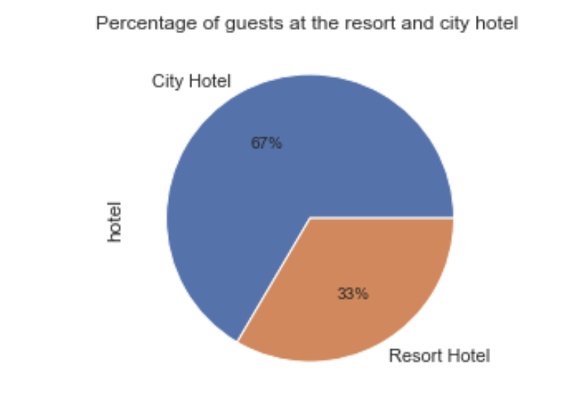
EDA
Visualizing of the columns data:
In order to analyze the data we created graph visualization of part of the columns:
Percentage distribution of observations by hotel:
Notes:
רן

Slide 10
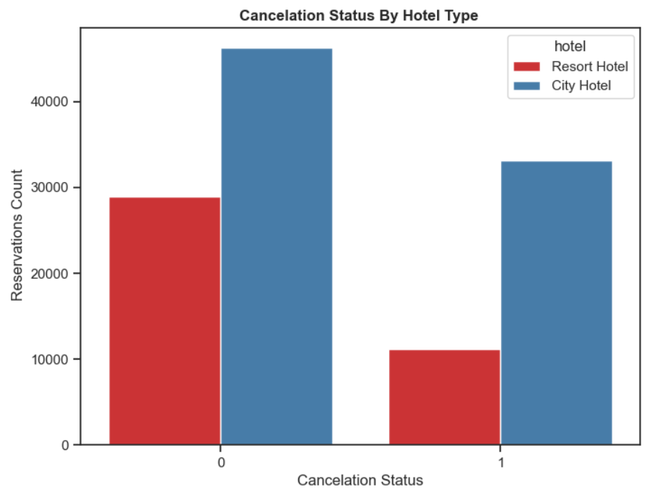
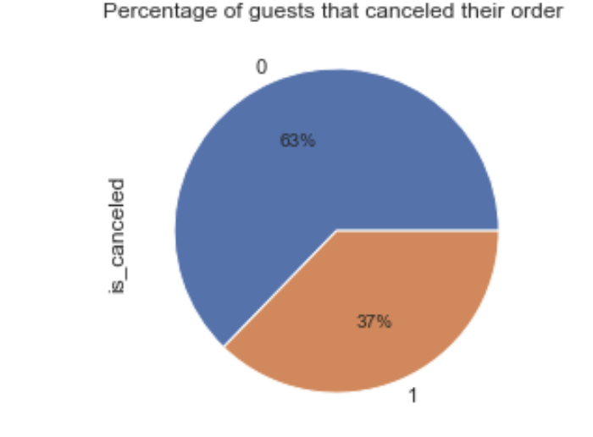
According to the pie chart, 63% bookings were not cancelled and 37% of the bookings were cancelled at the Hotel.
Resort Hotel : Total of 25.14% Bookings were cancelled
City Hotel : Total of 74.85% Bookings were cancelled

Slide 11
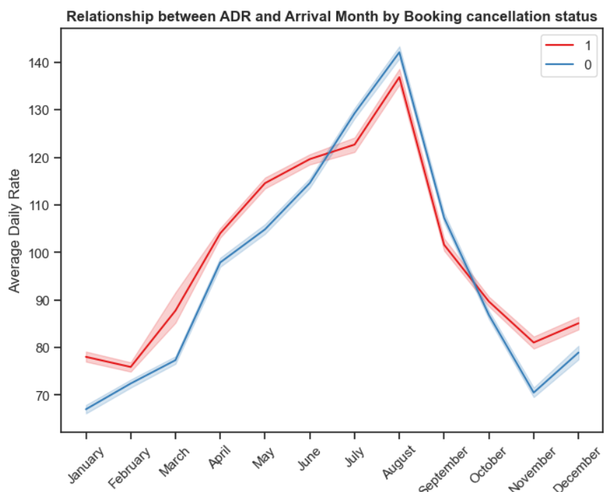
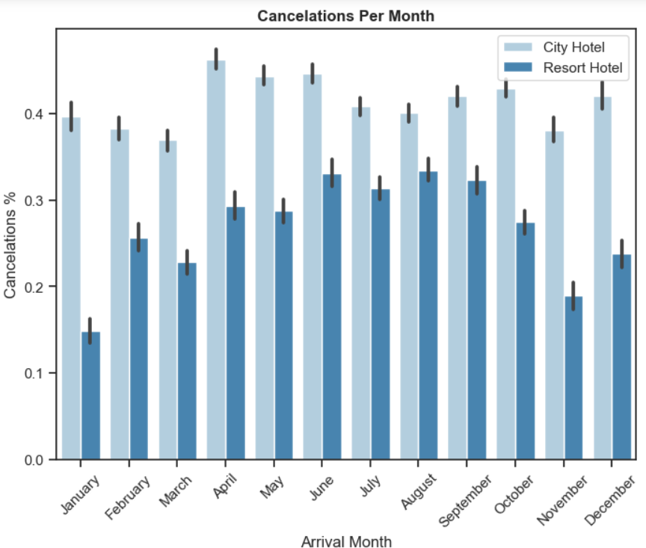
August is the most occupied (Busiest) month of bookings.
Highest Average Daily Rate(ADR) is in August may be it could be one of the reasons for more canceled bookings.
City hotel : The number of cancelations per month is around 40% throughout the year.
Resort hotel : The number of cancellations are highest in the summer (June,July, August) and lowest during the winter (November,December,January). In short, the possibility of cancellation for resort hotels in winter is very low.

Slide 12
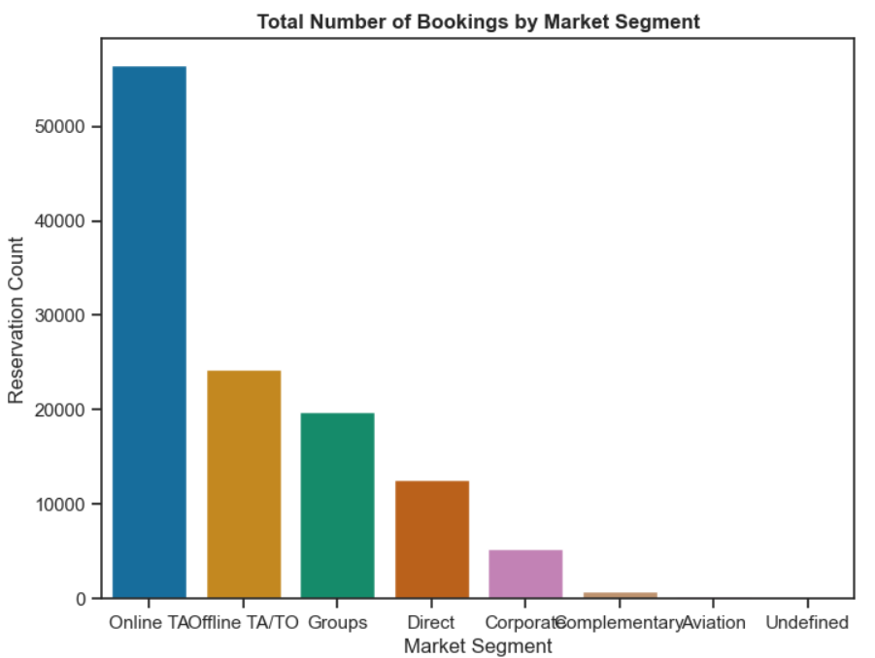
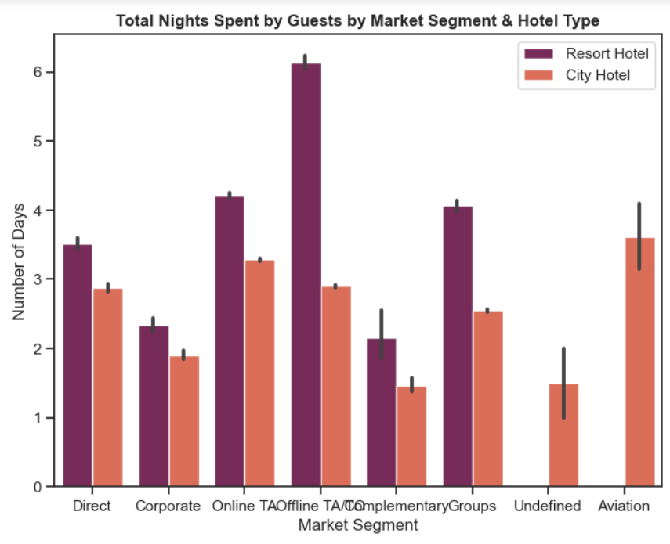
Above graph depicts that 47.3% of bookings are made via Online Travel Agents
Around 20% of bookings are made via Offline Travel Agents and less than 20% of bookings made directly without any Agents
City Hotel: Most of guests prefer to stay between 1-4 nights
Resort Hotel : Most of the guests prefer to stay more than 3 nights

Slide 13
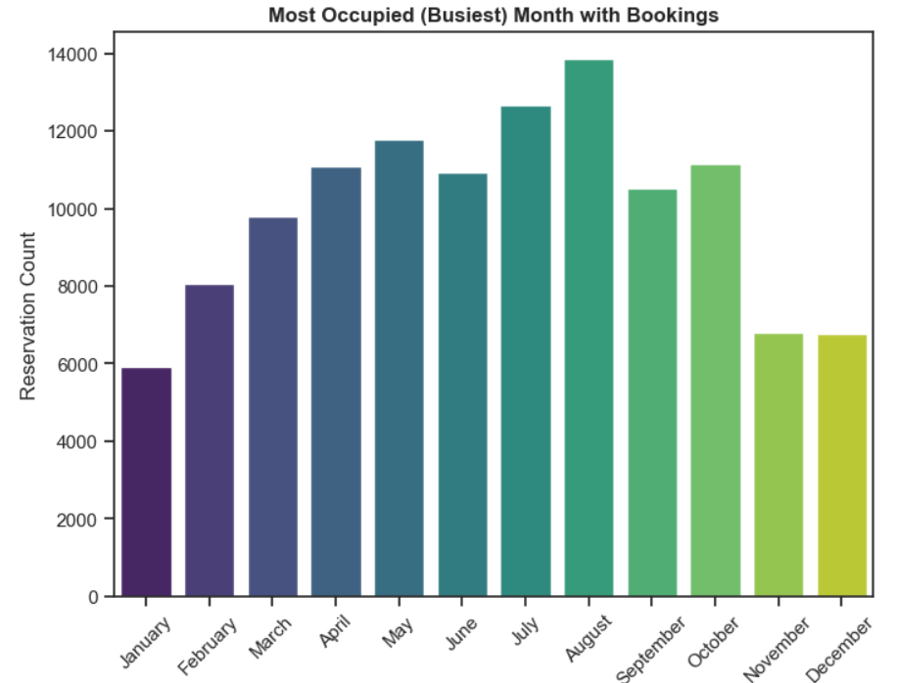
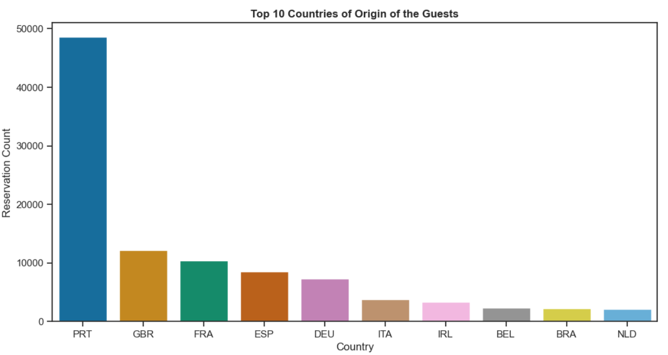
About 40% of all bookings are created from Portugal followed by Great Britain (10%) & France (8%)
August is the most occupied (busiest) month with 11.62% bookings and January is the most unoccupied month with 4.96% bookings.

Slide 14
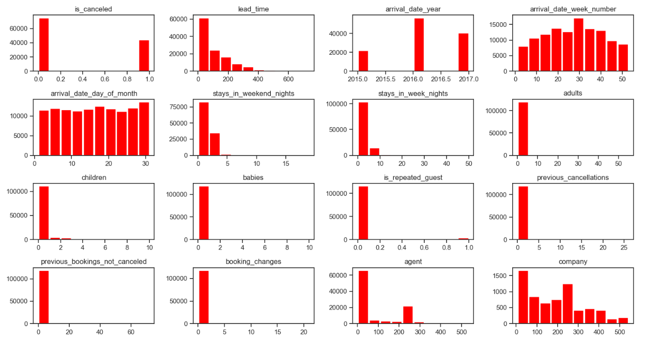
Visualisation of Numerical columns
1. A lof of bookings where made in 2016.
2. Repeated guests do not cancel many bookings.
3. Booking changes does not quite affect cancelling bookings since there were no much changes made.

Slide 15
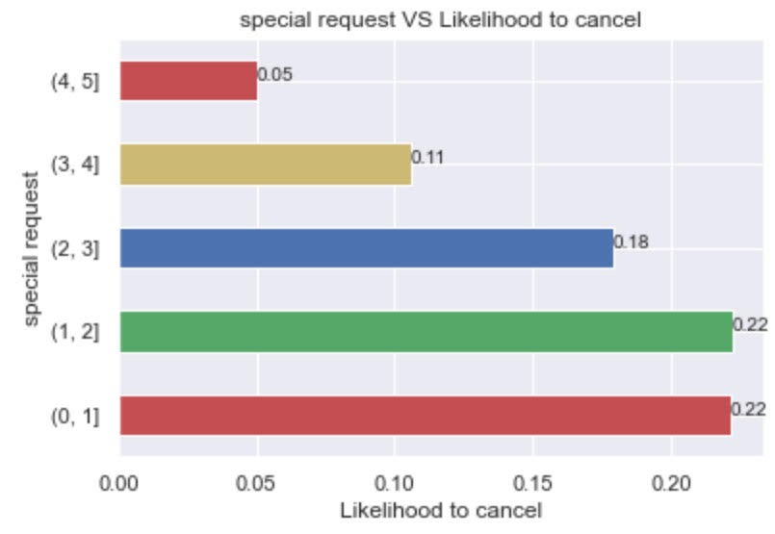
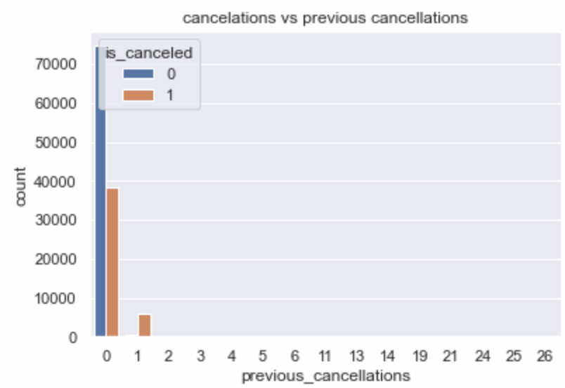
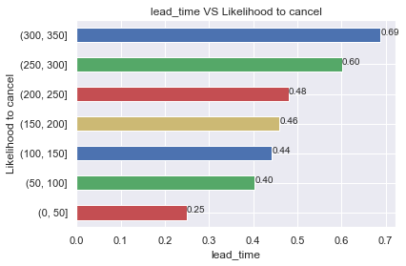
ANALYSING THE DATASET
Total number of special requests
Previous cancellations history
Lead Time versus likelihood to cancel
Тhe number of special requests raises the chances of cancelation decrease.
The rate of cancellation for customers who have cancelled previously is significantly higher
The chance of cancellation is higher the longer in advance a room is booked
6
Notes:
רן

Slide 16
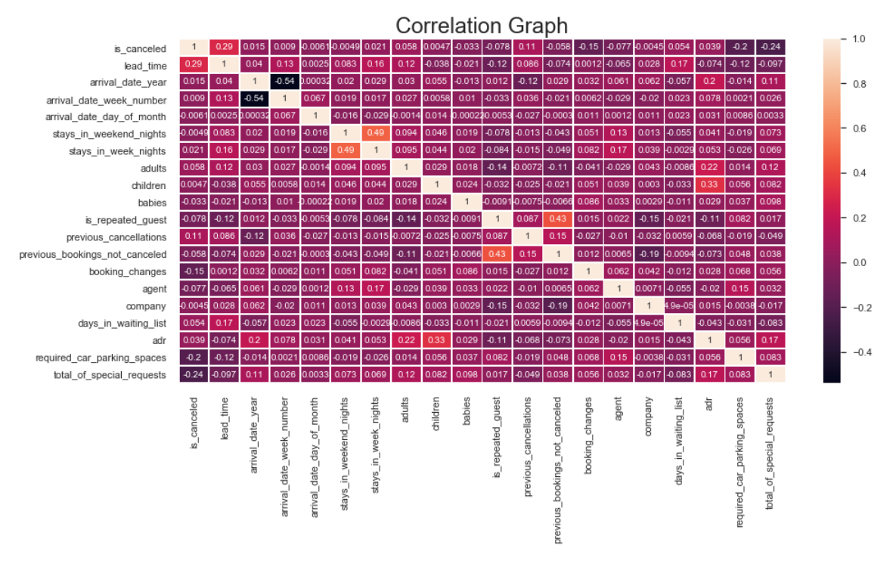
4
Notes:
We can see that the highest correlated attributes are: lead_time, previous_cancelations ,booking_changes ,required_car_parking_spaces,total_of_special_requests

Slide 17
We can see that the highest correlated attributes are:
lead_time
previous_cancelations
booking_changes
required_car_parking_spaces
total_of_special_requests
Notes:
רן

Slide 18
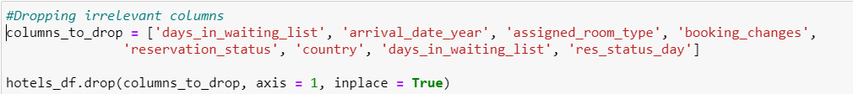
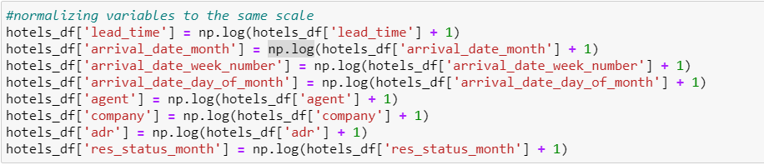
PREPARING THE DATASET FOR MODELLING
Checking for NaN values,
Dropping irrelevant columns
Introducing dummy variables
Scaling the data
Notes:
בני

Slide 19



MODEL BUILDING
Logistic regression
Decision tree classifier
Random forest classifier
In order to predict the outcome of the booking I decided to employ a few ML models and then compare between them for the best results. Since the problem is a classification problem, we will stick to classification models.
Evaluation: Precision, recall, f1, ROC/AUC
Notes:
בני

Slide 20

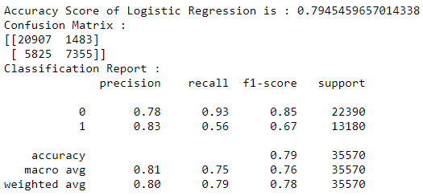
LOGISTIC REGRESSION
Logistic regression is a statistical model that allows us to estimate the probability of certain events. It is based on the logistic function to model a binary dependent variable. In this project we model the probability of a dependent variable (“is_cancelled”) to equal 1.
Your logo
10
Notes:
איגור

Slide 21
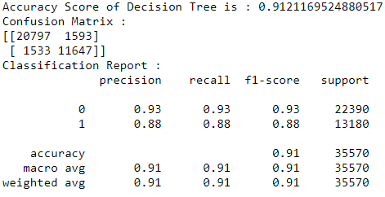
Decision tree classifier
Decision three is a predictive modelling approach that uses a decision tree to go from observations about an item (represented in the branches) to conclusions about the item's target value (represented in the leaves). In the current project we used sklearn.tree.DecisionTreeClassifier() function with its default parameters.
10
Notes:
איגור

Slide 22
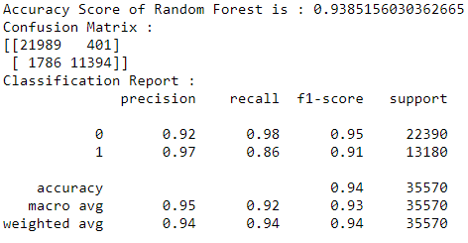
RANDOM FOREST
Random forest classifier is an ensemble learning method for classification, regression and other tasks that operates by constructing a multitude of decision trees at training time. For classification tasks, the output of the random forest is the class selected by most trees.
In the current project we used sklearn.tree.DecisionTreeClassifier() function with its default parameters. In the current project we used sklearn.ensemble.RandomForestClassifier() function with its default parameters.
10
Notes:
איגור/קטיה

Slide 23
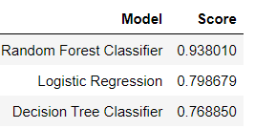
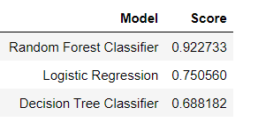
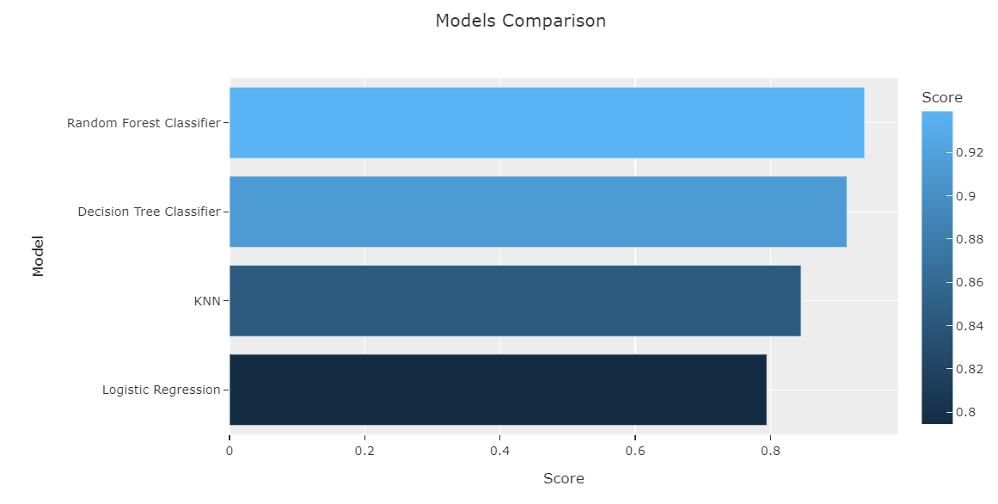
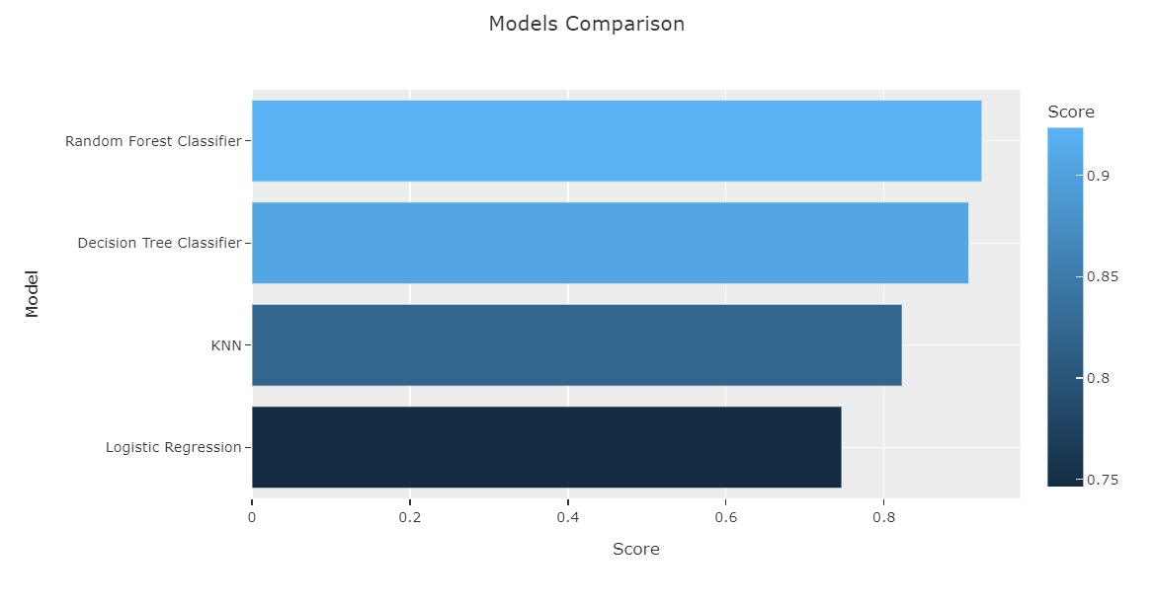
MODEL COMPARISON
Accuracy score
ROC/AUC score
ROC/AUC score
ROC = specificity/sensitivity
AUC = separability
7
Notes:
קטיה

Slide 24
CONCLUSION
The goal was to build a model that will be able to predict the probability of order cancellation based on the booking details. I built three different models, employing logistic regression, decision tree classifier and random forest algorithms.
It is concluded that the Random forest classification model performs the best for this type of task. It has highest accuracy score and ROC/AUC score (capability of model to distinguish between the classes)
9
Notes:
קטיה

Slide 25
CONCLUSION
By performing EDA it is found that there is a high chance of cancellation when the customer had previous cancellations; additionally, being a repeated guest is a factor promoting a higher probability of ordering. As the dataset contained relatively few observations containing these features, additional data on these cases--repeated guests and cancellation history--would enhance the accuracy of the model.
Directions for future analysis: I think we can improve the research by adding more features to the data. For example, we could require data on hotel quality, availability of different meal preferences, stay prices, pool availability, hotel type, resort availability, attractions etc. This data can add significantly to the model precision and therefore increase the marketing value of the product.
9
Notes:
קטיה

Slide 26
CONCLUSION
Despite the fact that the model could be improved through enhancement of the dataset--by adding hotels, observations, features, etc.--this work still provides a predictive model with an accuracy of 93.8% accuracy--much better than the coin toss.
9
Notes:
קטיה

Slide 27

THANK YOU

